Slide 1


Product recommendation analysis based on product attributes and reviews
Notes:
Good morning everyone, I am Akshat Singhal and I along with my teammate Adarsh Bandi completed a shadow project for our client TWM, under the guidance of our manager Vishwajyoti.
This project was based on the Product recommendation analysis based on product attributes and reviews.
To be more specific, we did an analysis on all the whiskey products available on the TWM website.
So, lets begin.

Slide 2
Section 1
Problem Statement

Slide 3

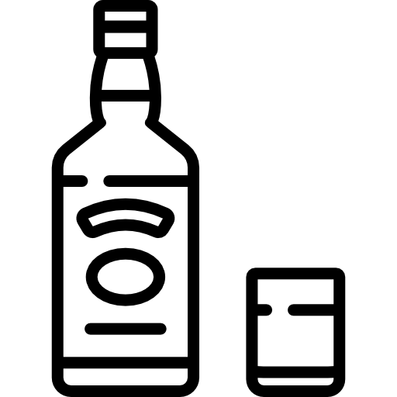



The background to our problem is...
Whiskey product
Product purchased on the TWM website
Product tasted by the customer
Product is recommended further by the customer
Product gets ratings and reviews based on its quality, taste, etc.
Notes:
-Let's start with the background of our problem:
-There are many whiskey products available on the TWM website. Whenever a product is purchased, it is tasted by the customer, and he visits the TWM website to provide the feedback for that product.
Each pdt receives a rating and a review based on the customer experience.
After that, the pdt may or may not be recommended further by the customer. This is the normal case scenario.

Slide 4
Defining Problem Statement
Business Problem
Whenever a product is purchased, it receives a rating as well as a review by the customer on the product webpage based on several factors like its taste, price, quality, etc.
Based on its ratings and reviews, the product may or may not be recommended further.
Many a times, the recommendation details for a product are not available on the product webpage.
So, the main problem is to investigate the possible reason for the missing recommendation details and find a way to get the recommendation details for such products.
Solution proposed
We will analyze the details of the products such as price of the product, ratings and reviews provided to find the main reason behind missing recommendation details. Finally, we will apply different ML models to predict the recommendation percent for these products.
Notes:
Now we define our main problem statement:
-If any pdt is purchased on TWM website, it receives a rating and reviews based on its taste, price, etc.
-Based on these factors, the pdt may or may not be recommend further.
-But sometimes, the recommendation details about a product are missing on the webpage. It is difficult for the customer to categorize it as a good or a bad pdt just based on ratings and reviews.
- So, the main problem is to investigate the possible reason for the missing recommendation details and find a way to get the recommendation details for such products.
To tackle this situation, we propose a solution. We will analyze the pdt details using several factors like price of the pdt, avg ratings of the pdt, reviews and find the main reason behind missing recommendation details.
Finally, we will apply different ML models to predict the recommendation percent for these products.

Slide 5
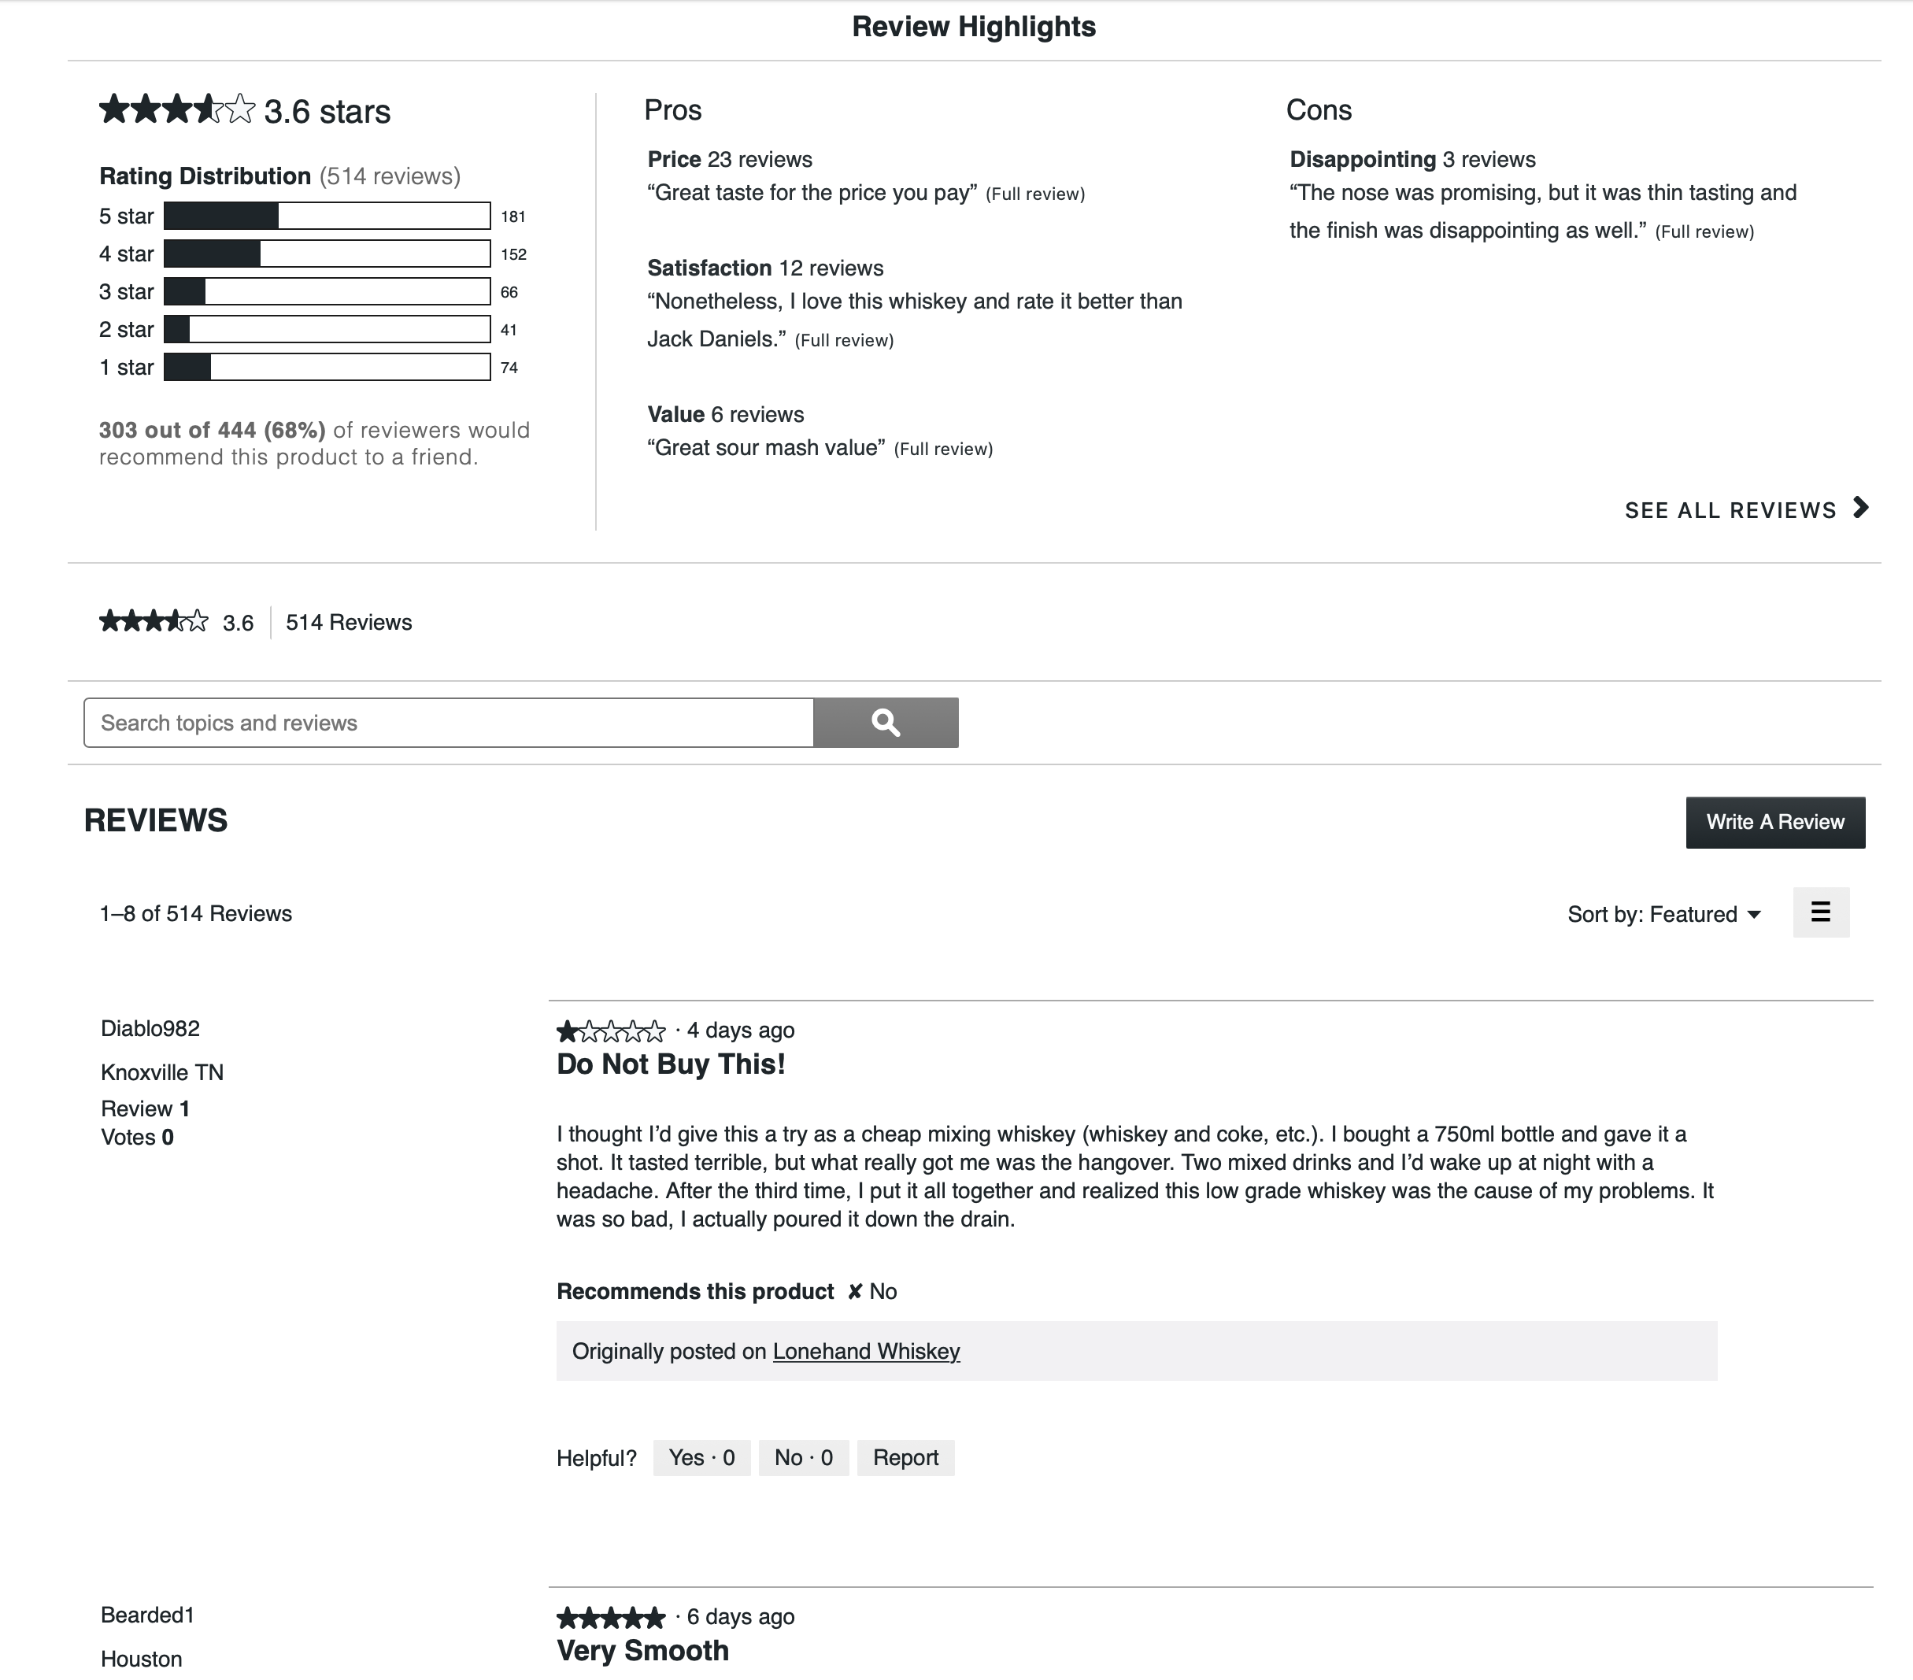
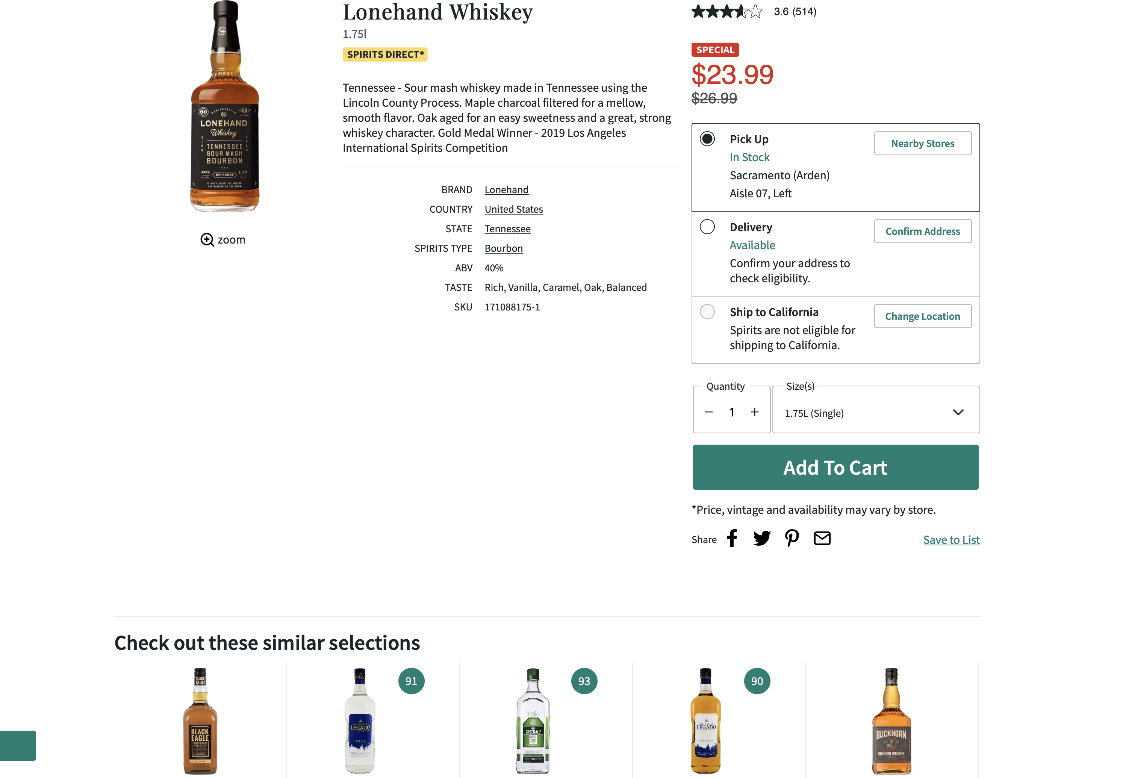
Web scrapping
Cons list
Average rating
Pros list
Product Name
Rating Distribution
Price per unit
Recommendation percent
Review title
Review text
Similar product details
Notes:
-Before we begin our analysis, we need some data around ratings, reviews and other details of the products.
-We extracted different entities from the product page, like Name, price, similar pdt details, …………, and recommendation percent from the product page.
We performed this extraction for all the whiskey products available on TWM website.

Slide 6
About dataset
Basic details of the product
Rows = 1697
Independent variable
Columns = [Product name, Price per unit, top 5 similar product’s details ]
Rating details of the product
Rows = 1697
Independent variable
Dataset
(containing whiskey products only)
Columns = [Average rating, Rating count, Individual counts of 1–5-star ratings]
Reviews of the product
Rows = 1467
Independent variable
Columns = [Pros list, Cons list, Review text, Review title]
Recommendation details of the product
Rows = 1191
Dependent variable
Columns = [Recommendation percent, total recommendation count]
Notes:
-After completion of extraction, we had our final dataset to begin our analysis.
-After cleaning our dataset, we found that there are total 1697 unique whiskey pdts on TWM website.
Each pdt had its price tag, average rating and its distribution.
But some of the pdts didn’t contain reviews at all by the customers. Only 1467 pdts had review details.
And many of the pdts didn’t contain recommendation details on their webpage. There were only 1191 products, that is about 70% of total pdts, that had recommendation information about the product. This will be our target variable.

Slide 7
Section 2
Exploratory Data Analysis
Notes:
After we had our problem statement in hand, we did some EDA on our extracted dataset.

Slide 8
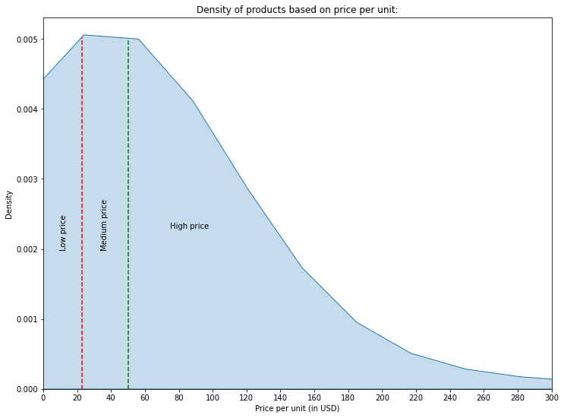
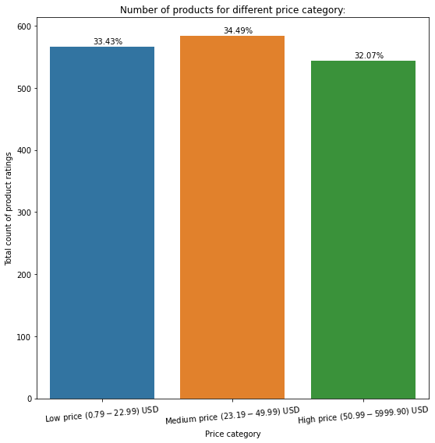
Distribution of price for different products:
Price per unit of whiskey products ranges from $0.79 to $5,999.90 which is further binned into 3 categories (Low price, Medium price, High price) such that total number of products within each category remains almost same.
Notes:
This is the distribution of price for different whiskey pdts
The density distribution of price is somewhat right skewed.
We categorized the prices of the pdts into 3 broad categories which are low price, medium and high priced.
The categories were made such that each category had almost same number of pdts.
So finally, we see that low price pdts have a price range of 0.79 to 22.99 $
Similarly medium priced pdts range from 23.19 to 49.99 $ and high price from 50.99. $ to approximately 6000 $
As visible from graph, all the categories contain roughly same number of pdts.

Slide 9
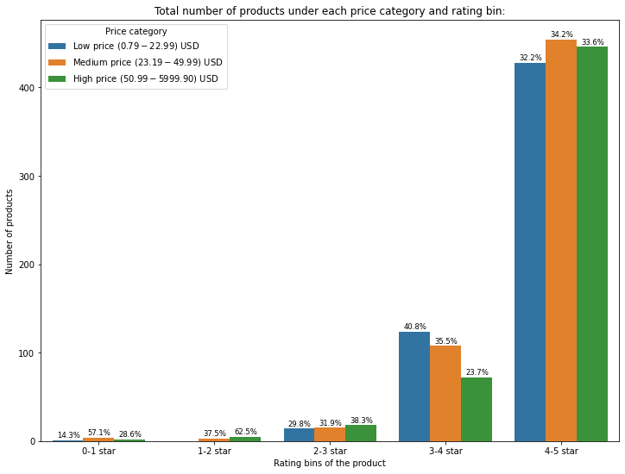
Distribution of products based on rating and price
Out of 1694 products, 78% of total products belong to 4-5 star rating category.
Almost 1632 (97%) products have rating >3 star , while average rating of all the products is around 4.39
In lower rating bins, high priced products have major contribution.
Notes:
This is the dist of all the whiskey pdts across different price range and rating bins.
As visible, majority of the pdts , that is almost 78% of total pdts belong to the highest rating bin i.e., 4-5 star.
Avg rating for all the pdts is 4.39 which means that overall, the customers seem happy with the whiskey pdts purchased from the TWM website.
However, when we closely observe low rated pdts, high priced pdts have major contribution. That means extremely high priced pdts are being rated low by the customers.

Slide 10
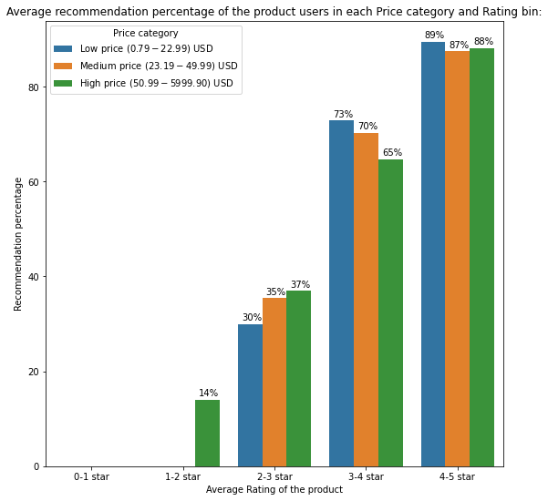
Variation of recommendation percent based on rating and price
The low-priced products with 3-4 and 4–5 star ratings were highly recommended compared to medium and high-priced products in the same rating bins.
In the low rated products, customers did not care to provide a recommendation feedback at all.
As the rating of the products decreased, recommendation percentage of the products also decreased, which tells about a correlation between the rating of the product and recommendation percentage.
Notes:
-This is the distribution of recommendation percent by users across different price range and rating bins.
The low priced pdts have high recommendations when their rating is high. People like lower priced pdts more and hence they rate them higher and recommend these pdts further.
The area with low rating bins is mostly empty. That is because the customers do not care much about the recommendation feedback for the pdts they don’t like.
There is also a negative trend in the recommendation percent when the rating of the pdt decreases, which tells there is a correlation between the 2 variables.

Slide 11
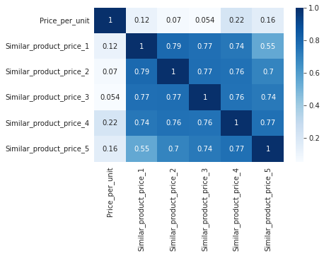
Similar products analysis
The following figure shows heatmap of correlation matrix for product price with price of similar products generated.
Based on the correlation value (max is 0.22) we can say that the similar products generated do not depend much on price.
Other hidden factors (not present on site) like department , category along with price maybe considered while generating recommendations.

Slide 12
Section 3
Data Preparation

Slide 13
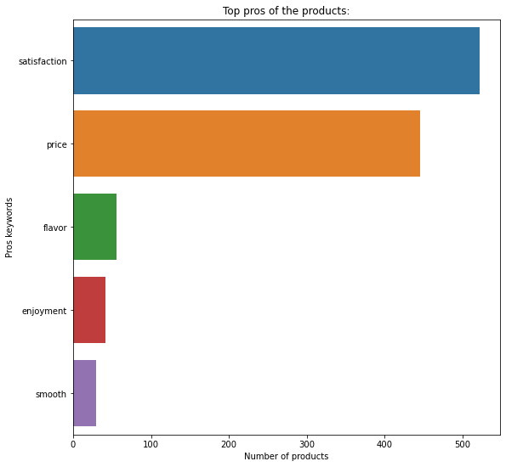
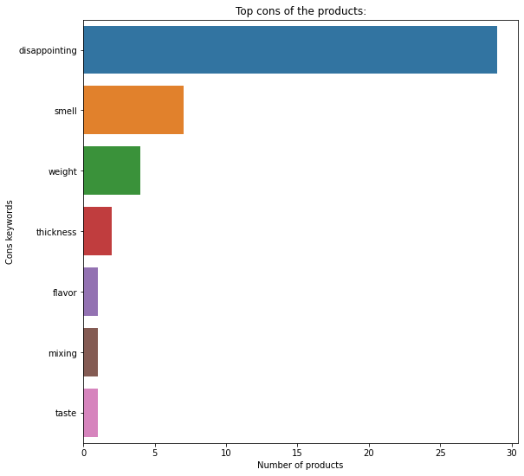
Pros and Cons
Pros keywords include words like satisfaction, price, flavor, etc. which shows that customers were satisfied with the price of the products and their flavor.
Cons keywords include words like disappointing, smell, weight, thickness, etc. which shows that some customers were disappointed with the smell of the products and their weight and thickness.
Notes:
We extracted the pros and cons list from the webpage of the product.
Major keywords present in pros list is satisfaction, flavor, price etc, from which we can interpret that the cust who were happy were satisfied with the price and flavor of the pdts.
And cons keyword include disappointing, smell, weight, thickness which can be interpreted as the cust who did not like the pdts were disappointed with the smell of the products and their weight and thickness.

Slide 14
Review Text Cleaning
The text cleaning part consisted of following steps:
Original Text
Orignal
Lowering the text
“A great sipping whiskey neat, on ice or with a mix. I have been quite pleased.”
Word-Tokenize
Cleaned
Stop words removal
great sipping whiskey neat , ice mix . quite pleased
Clean Text
Notes:
-Before moving to analysis of reviews, review text cleaning was done using nltk tokenizer and stopword removal.
- Lets say, The orginal review was…..

Slide 15
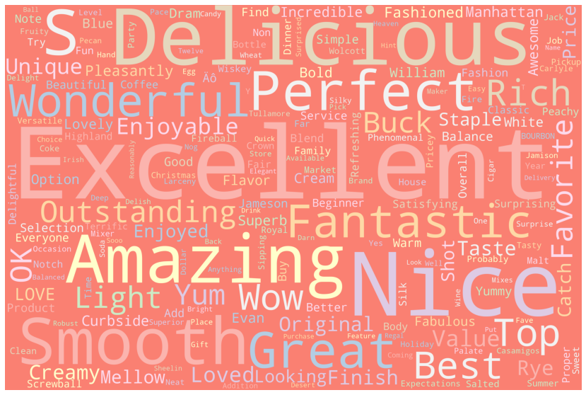
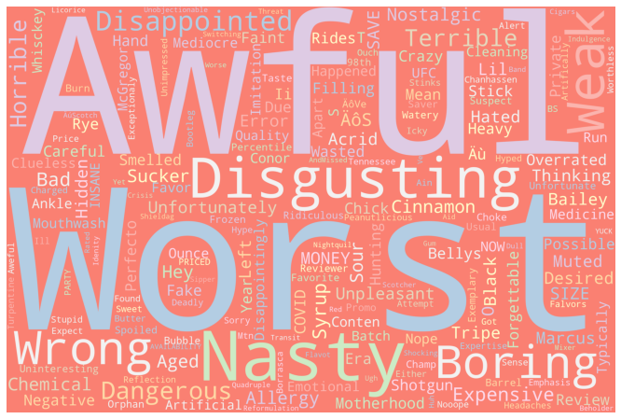
Sentiment analysis
Positive reviews keywords
Used “textblob” package on cleaned review text to generate sentiment score for all the reviews.
Averaged the sentiment scores of all reviews for a product for getting the final sentiment score for every product.
The number of products with negative final sentiment score was very less (almost 20 out of 1694 products) as compared to positive final sentiment products.
Negative reviews keywords
Notes:
-Sentiment analysis was performed on the reviews of the pdts given by the customers.
- We used a package named textblob to generate the sentiment score for all the reviews and then grouped these scores to get the average score for each pdt.
We observed that there were very few pdts that had negative average sentiment score, that is 20 out of 1694 pdts.
WORDCLOUD:
This is the wordcloud for all the positive reviews. As we can see, some of the common keywords for such reviews are excellent, delicious, smooth, etc.
On the other hand, wordcloud for all the negative reviews contain keywords like awful, worst, nasty, boring, disgusting, etc. which gives an overall glimpse of both the positive and negative reviews by the customers.

Slide 16
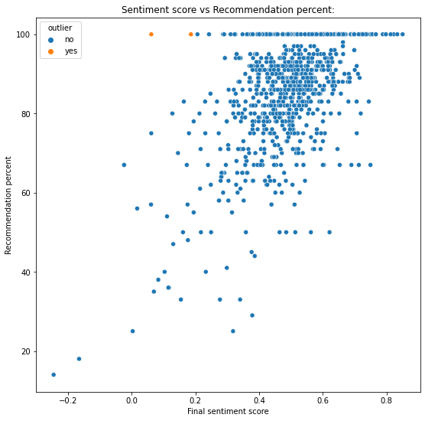
Sentiment score vs Recommendation percent
There is a positive correlation between the final sentiment score and the recommendation percentage of the product.
Majority of the products have recommendation percent more than 70%.
The products with negative sentiment score have very less recommendation percentage.
Despite having very low sentiment scores, these products have 100% recommendation:
Dimensions Laphroaig 21yr ($799.99)
Wilderness Trail Black Label Small Batch Bourbon ($39.99)
Notes:
There is a positive correlation between the final sentiment score and the recommendation percentage of the product.
Majority of the products have recommendation percent more than 70%.
The products with negative sentiment score have very less recommendation percentage.
There are some outlier products also visible here. Despite having very low sentiment scores, these products have 100% recommendation: ………

Slide 17
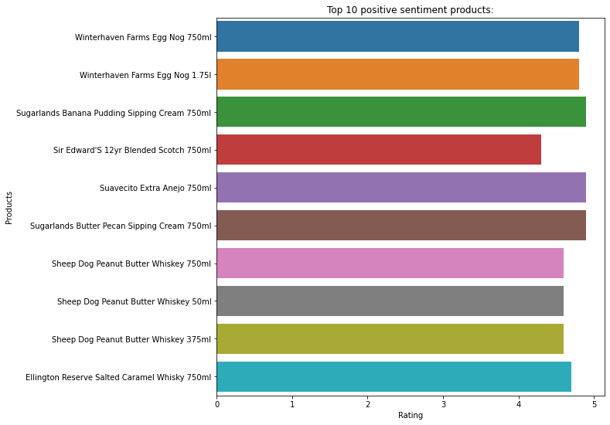
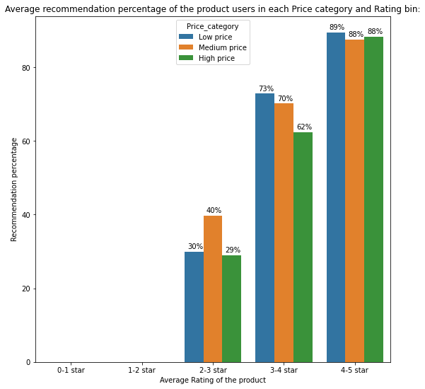
Positive Sentiment analysis
Top 10 positive sentiment products have rating more 4.5 stars.
For all the positive sentiment products whose rating is more than 4 star, the average recommendation percent is more than 85% i.e., these products are highly recommended by customers.
The recommendation percentage decreases as the rating of the product decreases.
Notes:
We performed sentiment analysis on reviews with both positive and negative sentiment score.
On the screen visible are the pdts that have the highest sentiment scores
Most of these pdts have more than 4.5 star rating.
For all the positive sentiment products whose rating is more than 4 star, the average recommendation percent is more than 85% i.e., these products are highly recommended by the customers.
And none of the pdts with positive sentiment score have less than 2 star rating.

Slide 18
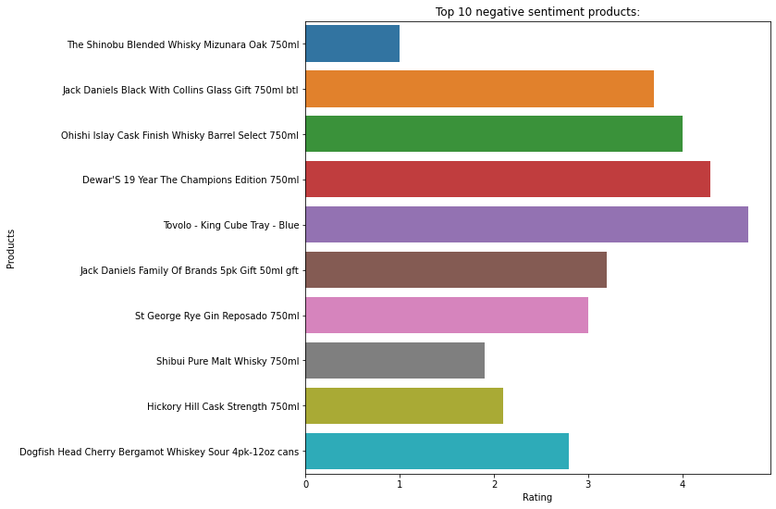
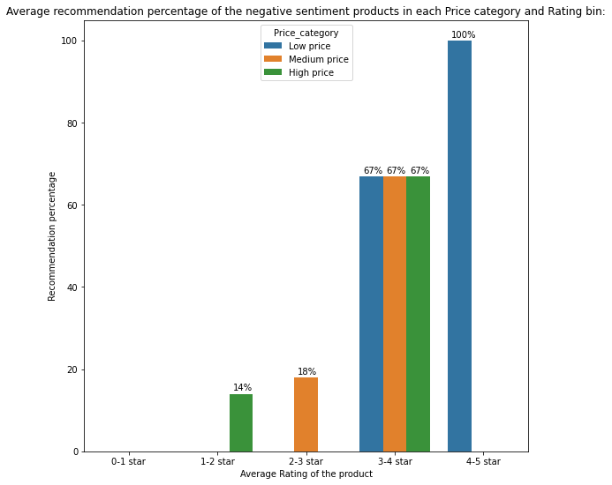
Negative Sentiment analysis
Most of the top 10 negative sentiment products have rating less than 4 star.
For these negative sentiment products, the average recommendation percent is very low.
Many negative sentiment products do not have the recommendation flag which shows that people who dislike the product tend to not to answer the question, whether they would recommend the product or not.
Notes:
-These are the pdts with lowest sentiment scores and most of them have a rating less than 4 star.
-For these pdts the recommendation percent is also very low.
-Here also, we can observe, recommendation feedback is absent mostly when the ratings are low and the pdts have a negative sentiment score.
- Customers provide low ratings and bad reviews for the pdts they don’t like but they don’t even care to provide the recommendation feedback to these pdts. This may be because Cust are so fed up with these pdts that they don’t wish to answer anything related to these pdts.
- So, this may be the main reason for the missing recommendation details on the pdt webpage.

Slide 19
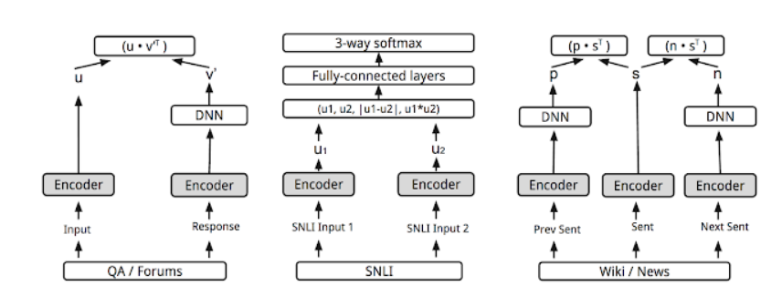
Word embeddings
Universal Sentence encoder (Google)
Used Universal Sentence Encoder by google on cleaned review text to generate word embeddings for all the reviews.
This encoder is based on two encoder models, and we can use either of the two:
Transformer
Deep Averaging Network(DAN)
The final sentence embedding contains 512 dimensions.
Notes:
-----
------
-------
We will finally use these embeddings to feed into our model as reviews are also an important part in predicting the recommendation percent for a pdt.

Slide 20
Section 4
Proposed Models &
Performance analysis
Notes:
** So Based on the extracted data for TWM Whiskey products & initial product insights we have built a prediction pipeline**
**The main goal of this model is to predict the recommendation score based on the available features related to the product on the website & also look into cases of products with no review data**

Slide 21
Different datasets for different levels of model
Level 1 : Data with basic details
Level 2 : Data with sentiment details
Level 3 : Data with review details & embeddings
Price per unit
Price per unit
Price per unit
Rating distribution
Rating distribution
Rating distribution
Sentiment score
Sentiment score
Pros list keywords and counts
Pros list keywords and counts
Cons list keywords and counts
Cons list keywords and counts
Review Word embeddings
Notes:
Before we go into the model details lets see how we have divided our datasets.
** The main reason why we have divided is to handle different kind of product scenarios. Some products only have basic details while others have all details & reviews. **
Level 1 : The dataset without any review details comes handy when we need to predict a baseline recommendation score for products without any reviews present or for a new launched product on that website.
Level 2& 3 : This model comes in handy when we want to get recommendation score for product with all details present.

Slide 22
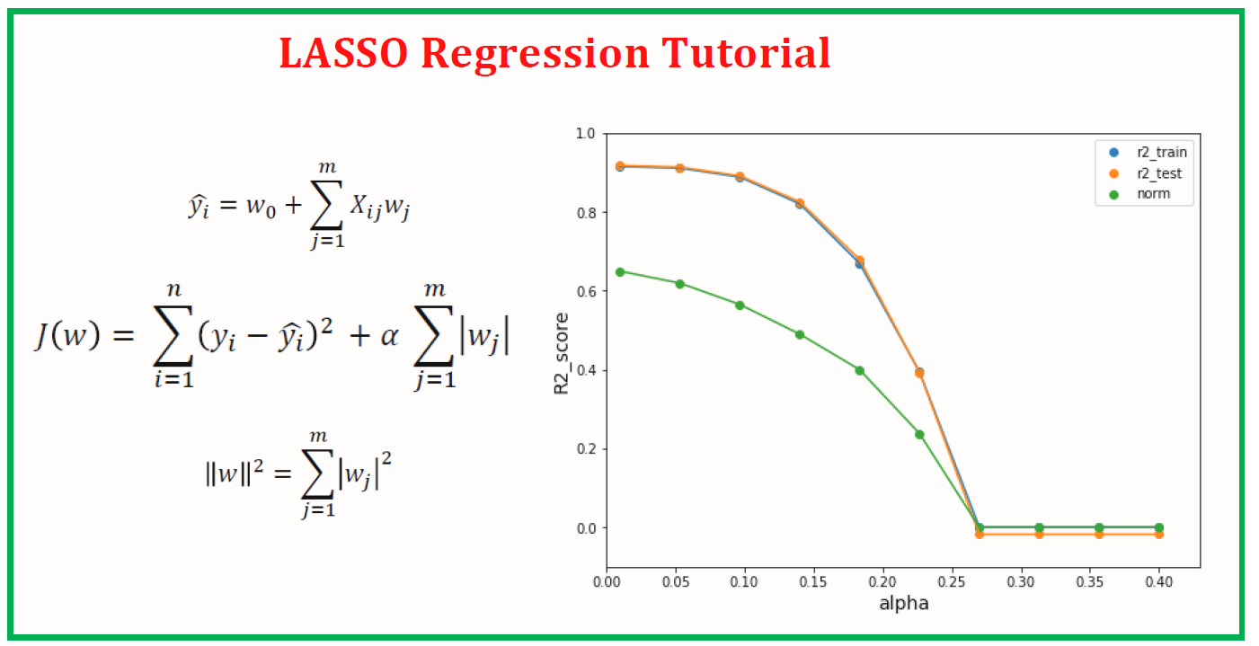
Lasso Regression
Model Performance
Model Introduction
→ Lasso regression is linear regression with L1 regularization
Data with embeddings
Data with basic details
Data with sentiment details
R2 score
0.08
R2 score
0.13
R2 score
0.82
Adj. R2 score
0.06
Adj. R2 score
0.09
Adj. R2 score
0.66
MAE
33.8
MAE
32.9
MAE
9.1
RMSE
37.9
RMSE
36.8
RMSE
17.2
Notes:
** we have tried various types of regressor models on this dataset & we have reported the top 3 better performing models.
** Lasso : Compare Accuracy values across three levels **
** This lasso regressor model performance increases as you go above in levels. It doesn’t perform well on level 1 & level2 datasets but does improve the performance on level3 **
Adjusted R2 = 1 – [ ( (1-R2) * (N-1) ) / (N-p-1) ]

Slide 23
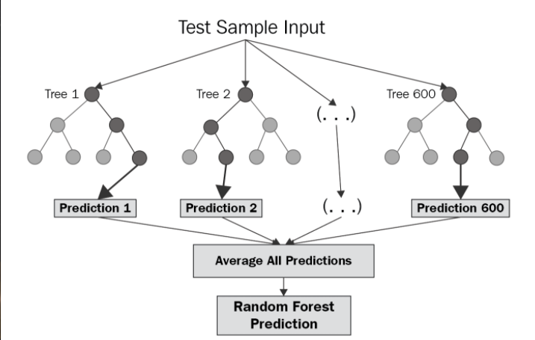
Random forest Regression
Model Performance
Model Introduction
Data with basic details
Data with sentiment details
Data with embeddings
R2 score
0.52
R2 score
0.92
R2 score
0.93
Adj. R2 score
0.50
Adj. R2 score
0.91
Adj. R2 score
0.85
MAE
18.4
MAE
7.06
MAE
6.72
RMSE
27.6
RMSE
11.14
RMSE
10.80
Notes:
** random forest : Compare Accuracy values across three levels **
** This lasso regressor model performance increases as you go above in levels **
Adjusted R2 = 1 – [ ( (1-R2) * (N-1) ) / (N-p-1) ]

Slide 24
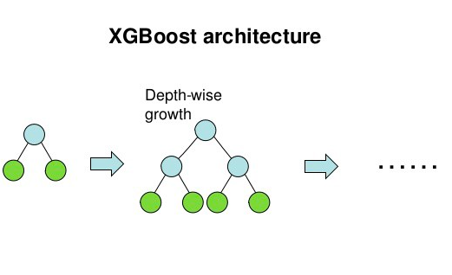
XGBoost Regression
Model Performance
Model Introduction
Data with basic details
Data with sentiment details
Data with embeddings
R2 score
0.51
R2 score
0.95
R2 score
0.96
Adj. R2 score
0.49
Adj. R2 score
0.95
Adj. R2 score
0.92
MAE
16.14
MAE
4.90
MAE
5.1
RMSE
27.9
RMSE
8.40
RMSE
8.18
Notes:
** XGBoost : Compare Accuracy values across three levels **
** This xgboost regressor model performs well on level 2, level 3 datasets when compared with previously seen models. **
** But for level1 dataset . The random forest performs better when compared to xgboost **
Adjusted R2 = 1 – [ ( (1-R2) * (N-1) ) / (N-p-1) ]
The dataset without any review details comes handy when we need to predict a baseline recommendation score for products without any reviews present or for a new product

Slide 25
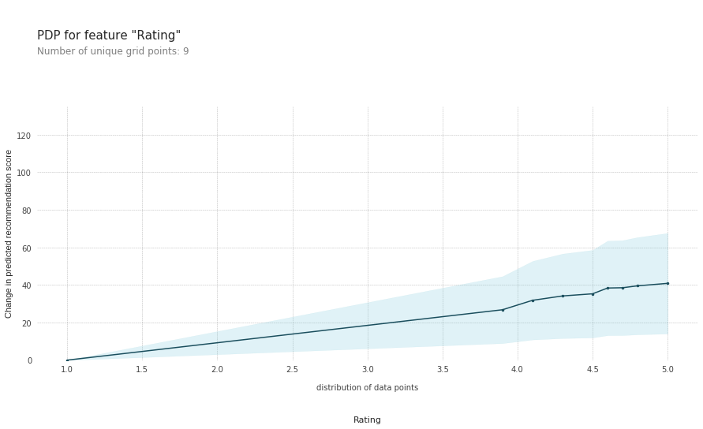
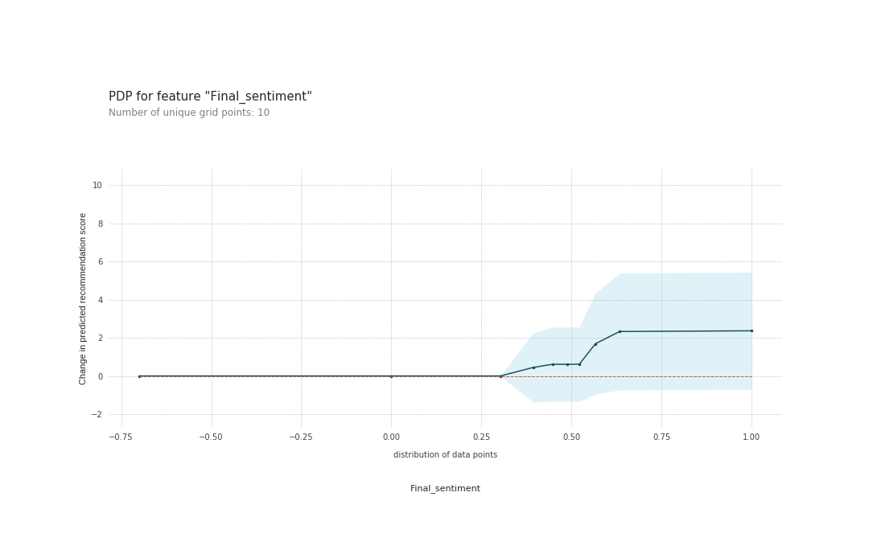
PDP for Rating & Final sentiment score
Predicted recommendation value
Predicted recommendation value
The Partial Dependence plots for features are generated using the best performing XGBoost regressor model.
Increase in average rating of product leads to continuous increase in recommendation percent when the rating crosses the baseline threshold of “1 star rating”.
Recommendation percent also increases when the sentiment score of the reviews (generated from sentiment analysis), crosses the threshold score of 0.25 and becomes constant after 0.75.
Notes:
We want to see how our input features have impacted or how our target variable (“recommendation score”). So we have generated partial-dependence plots for some important input features.*
w.r.t The rating feature there’s continuous increment in recomm percent which show pretty high positive impact on recommendation score output *
W.r.t the sentiment score feature , there is continuous increment beyond 0.25 score*
---
X-axis : values of features
Y-axis : change in value of predicted recommendation value w.r.t the feature values
Blue shaded area : level of confidence
Blue line : actual main plot
Red-dotted line : just zero line no significance

Slide 26
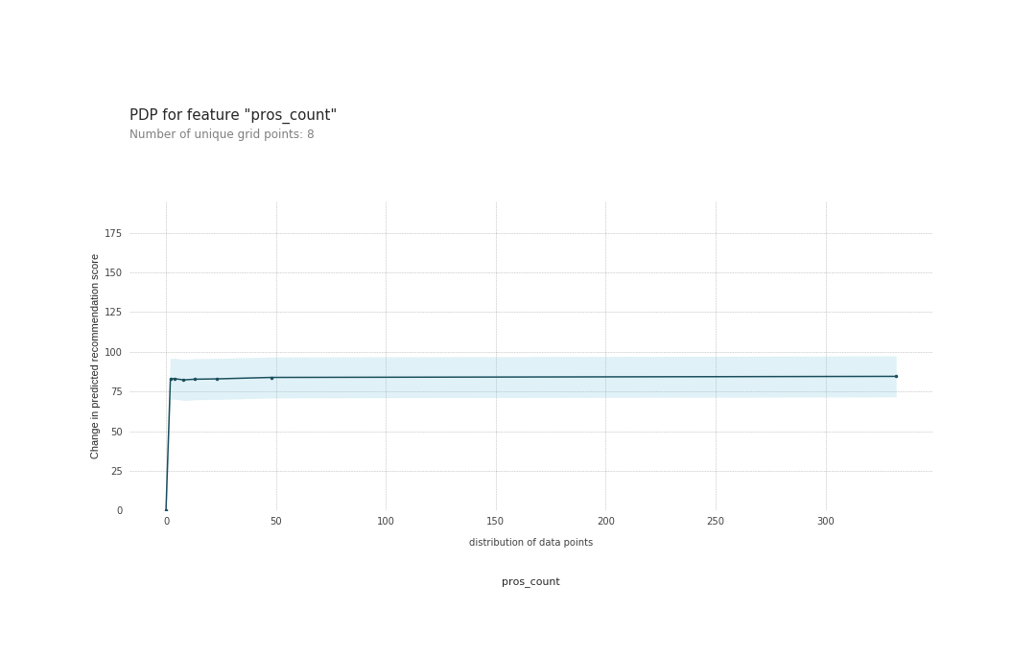
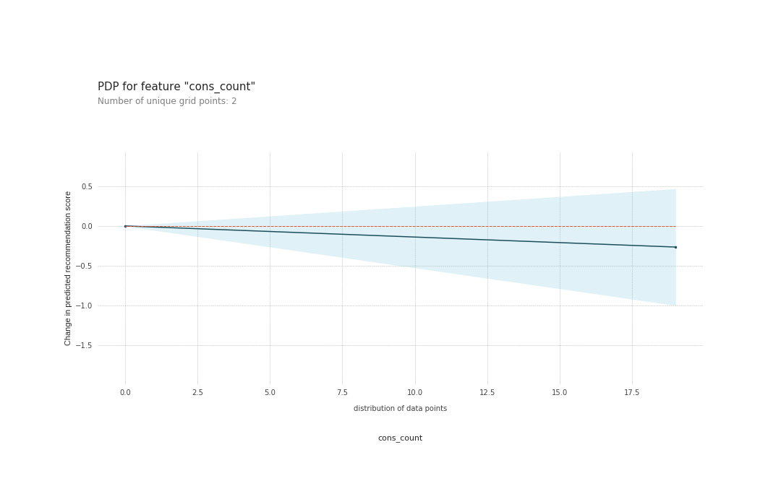
PDP for Pros count & Cons count
Predicted recommendation value
Predicted recommendation value
Increase in number of pros reviews for a product leads to rapid increase in recommendation percent .
But if number of pros reviews goes beyond 15 the increment is almost constant.
On the other hand , the recommendation percent decreases slowly as number of cons reviews increase beyond 0.
Notes:
*These clearly shows that more the no. of pro reviews , higher the recommendation percent by the model.*
*beyond 15 the increment in recommendation percent is almost constant -> lesser impact *
* There is continuous decrease in recomm percent as count of cons review increases*
*So based on these plots we can observe that , features like Rating , count of pros reviews , sentiment score have positive impact on the outcome of recommendation percentage. *
*And features like count of cons reviews & count of negative sentiment reviews have negative impact i.e, more the count of cons reviews lesser the value of recommendation percentage. *
But “cons_count” feature has less impact compared to the “pros_count” feature.
----
X-axis : values of features
Y-axis : change in value of predicted recommendation value w.r.t the feature values
Blue shaded area : level of confidence
Blue line : actual main plot
Red-dotted line : just zero line no significance

Slide 27
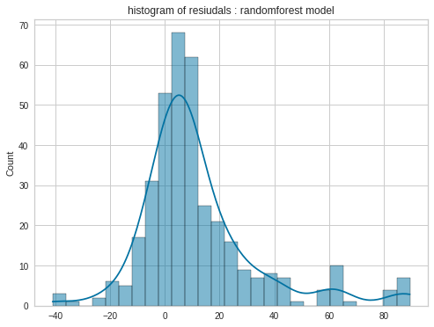
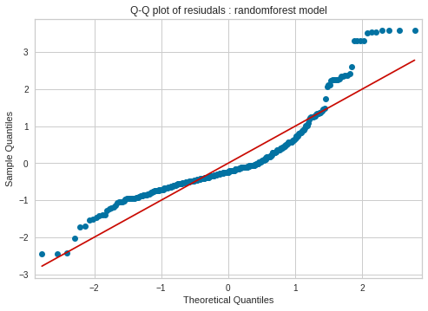
Model Interpretation for Level 1 dataset
On the dataset with basic details, the Random forest regressor model has better performance in terms of accuracy metrics.
Based on Q-Q plot & histogram of residuals , we can interpret that the residuals approximately follow a normal distribution.
Notes:
** Now let’s see some statistical observations like how the residuals of model generated are distributed , quantile-quantile plots etc. **
** for level1 dataset **
Random forest

Slide 28
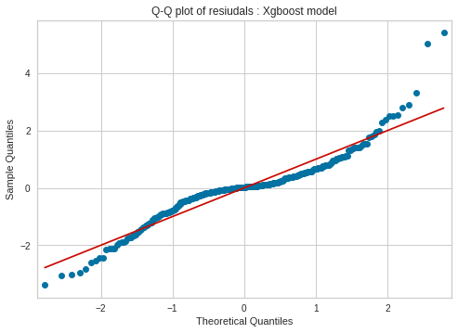
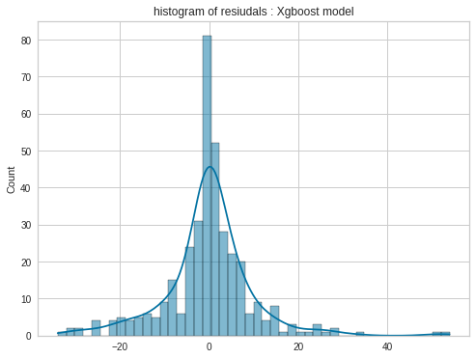
Model Interpretation for Level 2 dataset
The Q-Q plot & Histogram of residual values generated by XGBoost regressor on the dataset with sentiment details is plotted.
Based on that, we can interpret that the residuals are randomly distributed & approximately follow a normal distribution.
Notes:
** for level2 dataset **
xgboost

Slide 29
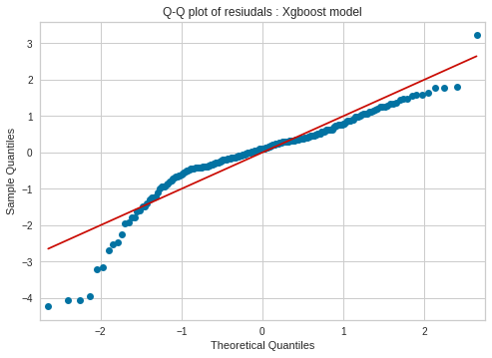
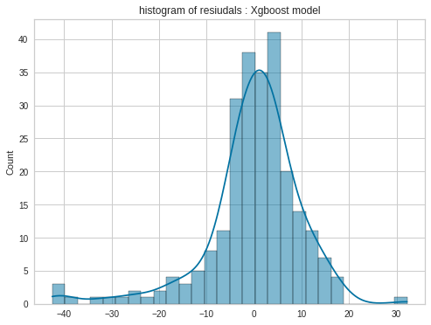
Model Interpretation for Level 3 dataset
The Q-Q plot & Histogram of residual values generated by XGBoost regressor on the dataset with embeddings is shown.
Based on that, we can interpret that the residuals approximately follow a normal distribution.
As the residuals are randomly distributed & follow a normal distribution the XGBoost model is better compared to other models.
Notes:
** for level3 dataset **
xgboost

Slide 30
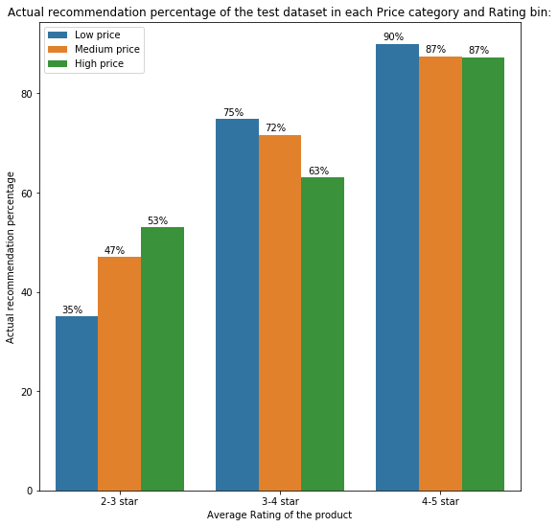
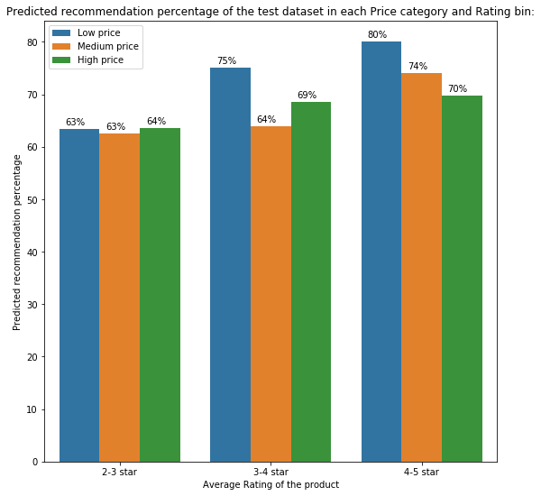
Results – Level 1 dataset
The model (Random Forest regressor) was tested on the test data (basic details) set and the predictions had an average recommendation score of 73.3% while actual average recommendation score was 84.3%.
The model works comparatively good for predicting the recommendation percentage of 3-4 star rating products.
The performance of the model drastically declines for the products with lower ratings (2-3 star) as the predicted percentages are much higher than actual recommendation percentage.
Notes:
Random forest : actual = 84.3 & predicted = 73

Slide 31
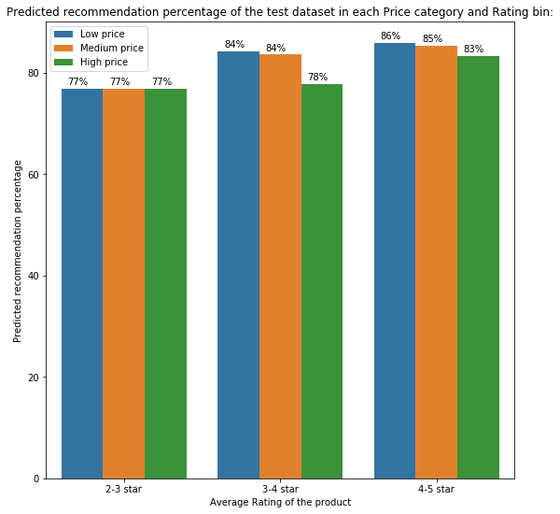
Results – Level 2 dataset
The model (XGBoost regressor) was tested on the test data set (with sentiment details) and the predictions had an average recommendation score of 84%.
There is negligible difference from actual average recommendation percent of test dataset.
The model works good for predicting the recommendation percentage of high rating products (4-5 star).
Notes:
With xgboost -> actual test avg : 84.30 , predicted test avg : 84.38

Slide 32
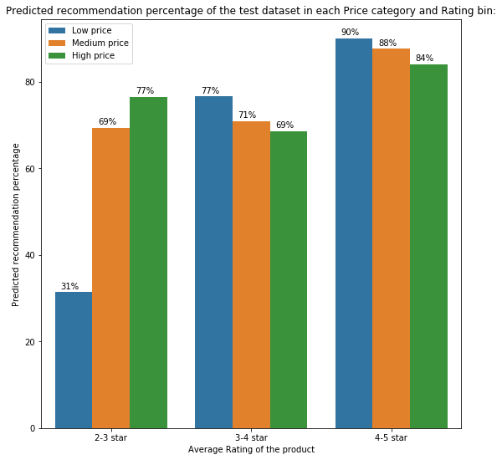
Results – Level 3 dataset
The model (XGBoost regressor) was tested on the test data set (with embeddings).
Here also, there is negligible difference from actual average recommendation percent of test dataset.
The model works good for predicting the recommendation percentage of products with ratings 3-4 and 4-5 star.
Out of all the 3 models, model with level 3 dataset performs better compared to other levels.
Notes:
With xgboost -> actual test avg : 84.30 , predicted test avg : 84.38
the main reason for being less is we're feeding even the embedding data of reviews apart from sentiment details & basic details
the performance of xgboost on even 3-4 stars is better compared to previous models
and out of these the level3 dataset performance is best

Slide 33
Section 5
Conclusion

Slide 34
Conclusion & Business aspects
Based on the reviews, ratings of various users for different products, this model predicts recommendation score which gives even more clear picture compared to manual recommendation feedback given by customers.
Based on that, we can decide whether to spend resources on those or, should we concentrate on other revenue generating products.
Also, we can analyze the sales of low rated (0-2 stars) products which are significant in number and take further steps to improve its sales if possible.
As recommendation score for some products is very low, we can analyze the number of sales & revenue for these products.
Notes:
*1st box : clear picture about the product *
*3rd box : can report these insights to the bussiness/client team *
Box1 : model score better than manual recommendation
Box2 : analyze sales of low revenue products
Box3 : after internal analysis , decide whether to spend resources on these or not
Box4 : also analyse low rated products sales & report possible actionable steps to business team*

Slide 35
Section 6
Learnings & Future Possibilities

Slide 36
Future Improvements
With larger dataset and expanding it to other types, DL & NLP state of art models can be used for more fruitful results and recommendation can be improved for products with lesser reviews.
Based on other details of product like categories, department etc., we can generate an initial recommendation score for newly launched products so that customers can get an idea about it.
With even more expanded dataset & customer information, we can provide personalized recommendation for different users.
Notes:
* Box 1 : in this we only analysed twm’s whiskey products. But we can expand it to other types like wine , beer etc & generate more impactful results *
* Box 3 : customer information like spend analysis , type of products he liked we can give a user-personalized recommendation score for the product apart from existing overall recommendation score *
Box1 : larger dataset -> state of art models & improve performance for lesser review products.
Box2 : on other internal details like department & category -> initial score for new products.
Box3 : personalized customer recommendation

Slide 37
Notes:
Q n A

Slide 38
Appendix A : Details of other models

Slide 39
Lasso Regression
Model Introduction
Model Performance
→ Lasso regression is linear regression with L1 regularization
Data without embeddings
Data with embeddings
R2 score
0.13
R2 score
0.82
Adj. R2 score
0.09
Adj. R2 score
0.66
MAE
32.9
MAE
9.1
RMSE
36.8
RMSE
17.2
Notes:
accuracy
Problem: Much time in gridsearch, thats why we didnt apply
Adjusted R2 = 1 – [ ( (1-R2) * (N-1) ) / (N-p-1) ]

Slide 40
Random Forest Regression
Model Introduction
Model Performance
Data without embeddings
Data with embeddings
R2 score
0.92
R2 score
0.93
Adj. R2 score
0.91
Adj. R2 score
0.85
MAE
7.06
MAE
6.72
RMSE
11.14
RMSE
10.80
Notes:
Accuracy : 0.921 ,
Problem: Much time in gridsearch, thats why we didnt apply
Adjusted R2 = 1 – [ ( (1-R2) * (N-1) ) / (N-p-1) ]
Adj r2 : 0.918 ,

Slide 41
XGBoost Regression
Model Performance
Model Introduction
Data without embeddings
Data with embeddings
R2 score
0.95
R2 score
0.96
Adj. R2 score
0.95
Adj. R2 score
0.92
MAE
4.90
MAE
5.1
RMSE
8.40
RMSE
8.18
Notes:
Accuracy -> 0.955 to 0.957
Problem: Much time in gridsearch, thats why we didnt apply
Adjusted R2 = 1 – [ ( (1-R2) * (N-1) ) / (N-p-1) ]
Adj r2 : 0.953 ,

Slide 42
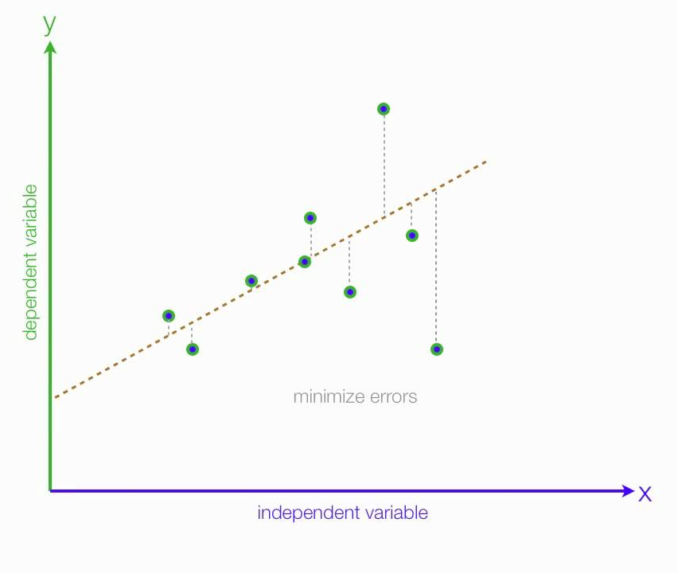
Linear Regression (OLS)
Model Introduction
Model Performance
Data without embeddings
Data with embeddings
R2 score
0.13
R2 score
0.75
Adj. R2 score
0.09
Adj. R2 score
0.59
MAE
33.1
MAE
11.1
RMSE
36.8
RMSE
19.5
Notes:
Accuracy
Problem: Much time in gridsearch, thats why we didnt apply
Adjusted R2 = 1 – [ ( (1-R2) * (N-1) ) / (N-p-1) ]

Slide 43
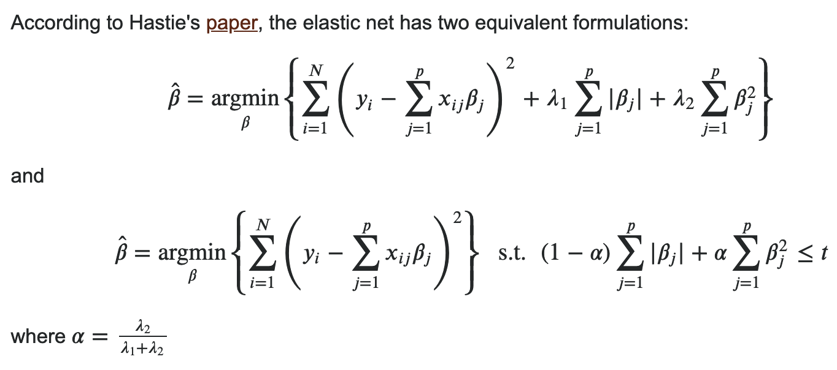
Elastic Net Regression
Model Introduction
Model Performance
→ Elastic Net is linear regression with both L1 & L2 regularizations together
Data without embeddings
Data with embeddings
R2 score
0.13
R2 score
0.64
Adj. R2 score
0.09
Adj. R2 score
0.39
MAE
32.9
MAE
17.6
RMSE
36.9
RMSE
23.7
Notes:
Accuracy : 0.126 , 0.63
Problem: Much time in gridsearch, thats why we didnt apply
Adjusted R2 = 1 – [ ( (1-R2) * (N-1) ) / (N-p-1) ]

Slide 44
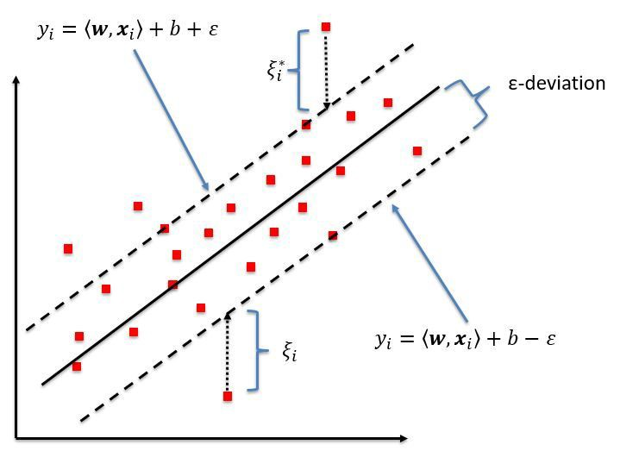
SVM Regression
Model Introduction
Model Performance
Data without embeddings
Data with embeddings
R2 score
0.01
R2 score
0.13
Adj. R2 score
-0.01
Adj. R2 score
-0.42
MAE
27.8
MAE
26.6
RMSE
31.4
RMSE
36.9
Notes:
accuracy
Problem: Much time in gridsearch, thats why we didnt apply
Adjusted R2 = 1 – [ ( (1-R2) * (N-1) ) / (N-p-1) ]
Ajdusted R2 is negative => with a small 𝑅2 and a high variable-to-sample size ratio , this can happen

Slide 45
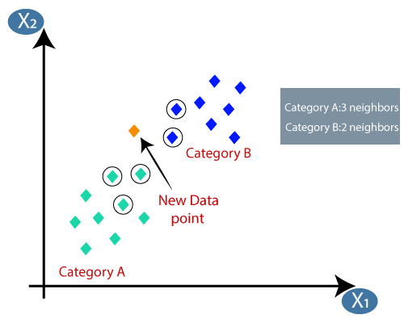
KNN Regression
Model Introduction
Model Performance
Data without embeddings
Data with embeddings
R2 score
0.37
R2 score
0.32
Adj. R2 score
0.34
Adj. R2 score
0.18
MAE
17.6
MAE
19.9
RMSE
31.8
RMSE
33.9
Notes:
Accuracy -> even though we increased features the r2 score for knn based regressor decreased
Problem: Much time in gridsearch, thats why we didnt apply
Adjusted R2 = 1 – [ ( (1-R2) * (N-1) ) / (N-p-1) ]

Slide 46
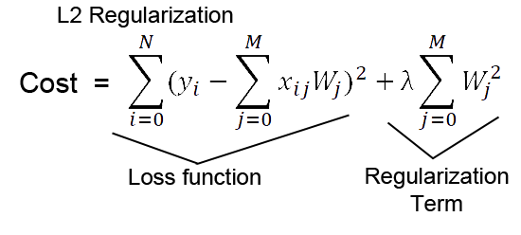
Ridge Regression
Model Introduction
Model Performance
Data without embeddings
Data with embeddings
→ Ridge regression is linear regression with L2 regularization
R2 score
0.13
R2 score
0.76
Adj. R2 score
0.09
Adj. R2 score
0.59
MAE
33.1
MAE
10.8
RMSE
36.8
RMSE
19.2
Notes:
accuracy
Problem: Much time in gridsearch, thats why we didnt apply
Adjusted R2 = 1 – [ ( (1-R2) * (N-1) ) / (N-p-1) ]

Slide 47
Appendix B : PDP plots for various features

Slide 48
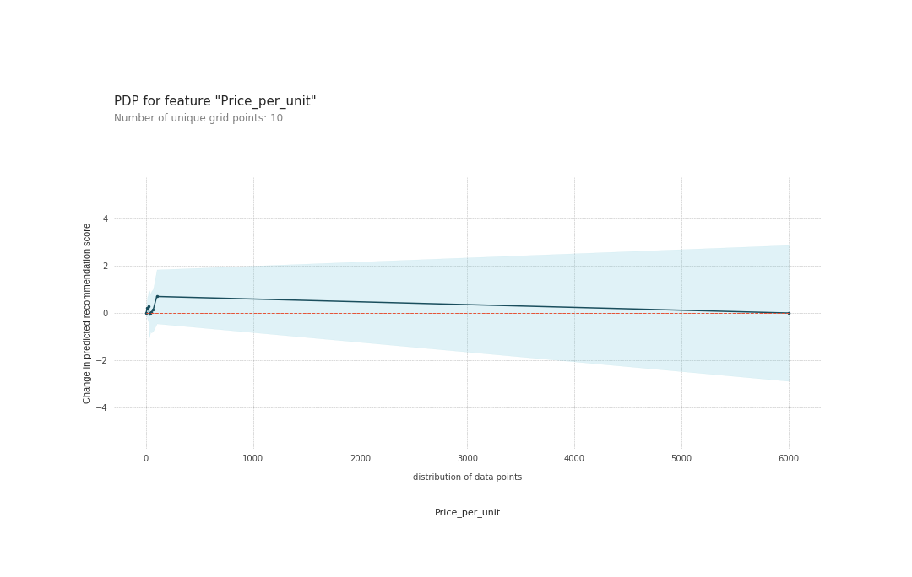
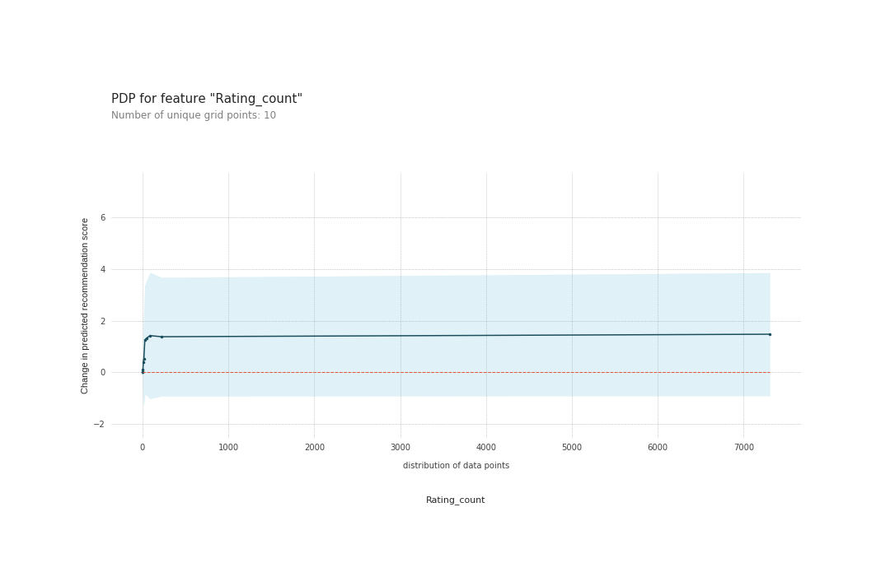
PDP for price & reviews count
Recommendation percent rapidly increases till price equals 200 $ and then slowly decreases beyond that price.
Also, as no. of ratings are more(means more people have bought it) , higher the recommendation percent.
Based on dependency of recommendation score on product price, we can interpret that people recommend the products based on quality but not solely based on price to recommend the product.
Notes:
X-axis : values of features
Y-axis : change in value of predicted recommendation value w.r.t the feature values
Blue shaded area : level of confidence
Blue line : actual main plot
Red-dotted line : just zero line no significance

Slide 49
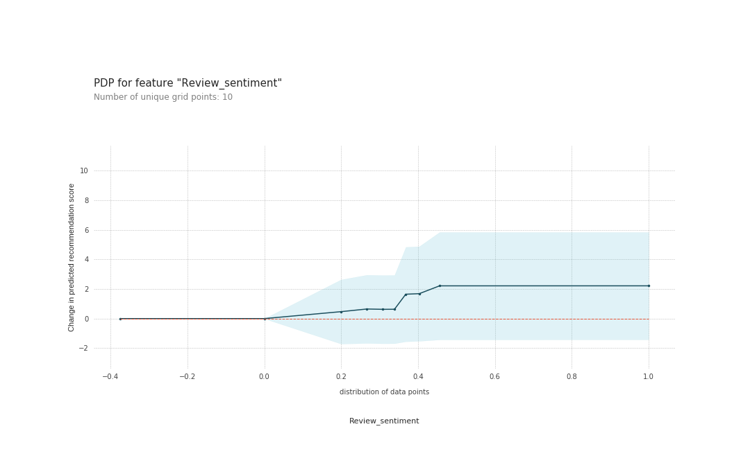
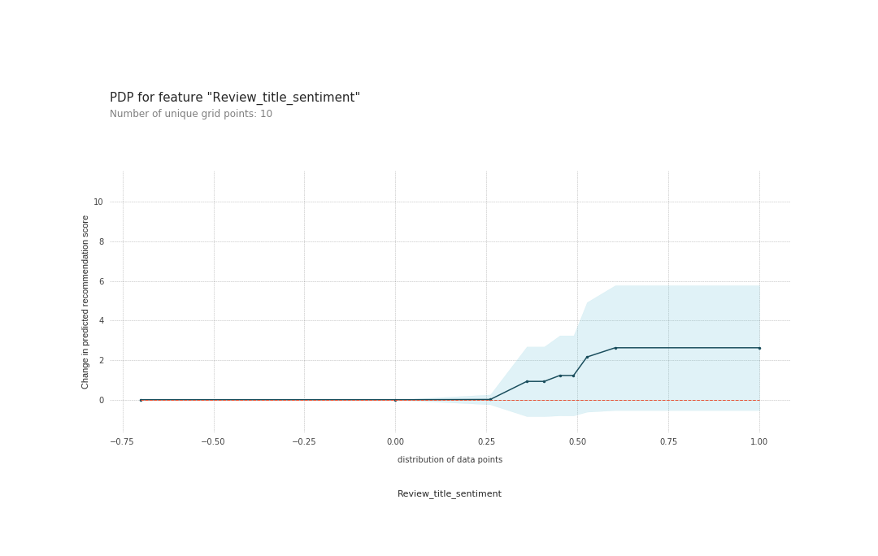
PDP for Review sentiment & Review title sentiment
The Partial Dependence plots are generated using the best performing XGBoost regressor model.
Recommendation percent increases when “review sentiment score” increases beyond 0 .
Similarly , Recommendation percent increases when “review title sentiment score” increases beyond 0.25.
These clearly shows that more positive the review better the recommendation percent by the model.
Notes:
X-axis : values of features
Y-axis : change in value of predicted recommendation value w.r.t the feature values
Blue shaded area : level of confidence
Blue line : actual main plot
Red-dotted line : just zero line no significance

Slide 50
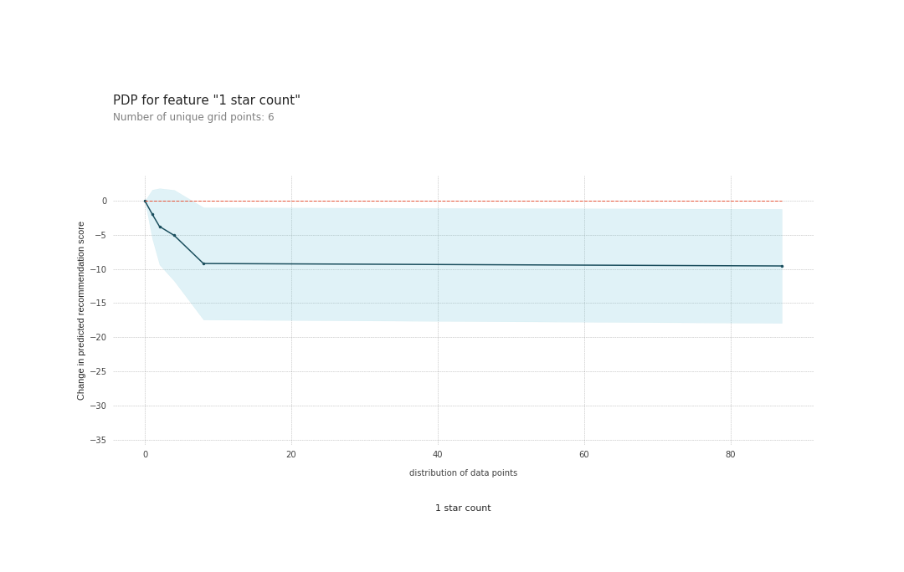
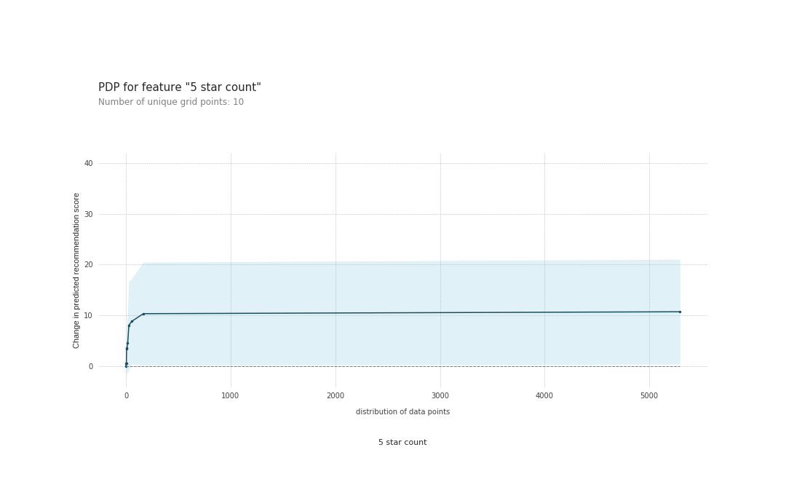
PDP for 1-star count & 5-star count
Recommendation percent decreases significantly when no. of 1-star ratings go beyond 0 till 40 & beyond remains almost constant.
On the other hand , Recommendation percent increases with increase in no. of 5-star ratings.
Similar pattern is observed in other star (2,3,4) ratings.
Based on this we can interpret that higher the product rating, higher the recommendation percent by the model and vice-versa.
Notes:
X-axis : values of features
Y-axis : change in value of predicted recommendation value w.r.t the feature values
Blue shaded area : level of confidence
Blue line : actual main plot
Red-dotted line : just zero line no significance

Slide 51
Model Interpretation
The Q-Q plot & Histogram of residual values generated by XGBoost regressor on test dataset is plotted. (shown above)
Based on that, we can interpret that the residuals approximately follow a normal distribution.
As the residuals are randomly distributed & follow a normal distribution the XGBoost model is better compared to other models.

Slide 52
PDP for Pros count & Cons count
The Partial Dependence plots for features are generated using the best performing XGBoost regressor model.
Recommendation percent increases when no. of pros reviews increases beyond 0 and remains almost constant beyond 50 count.
But Recommendation percent decreases as no. of cons reviews go beyond 0 , but the change is not very significant.
These clearly shows that more the no. of pro reviews , higher the recommendation percent by the model.
Notes:
X-axis : values of features
Y-axis : change in value of predicted recommendation value w.r.t the feature values
Blue shaded area : level of confidence
Blue line : actual main plot
Red-dotted line : just zero line no significance

Slide 53
PDP for Rating & Final sentiment score
Recommendation percent by the model increases significantly as average rating increases(>1.0).
Also , for negative sentiment score the recommendation percent is constant & beyond 0.25 score the recommendation percent by the model increases.
Notes:
X-axis : values of features
Y-axis : change in value of predicted recommendation value w.r.t the feature values
Blue shaded area : level of confidence
Blue line : actual main plot
Red-dotted line : just zero line no significance

Slide 54
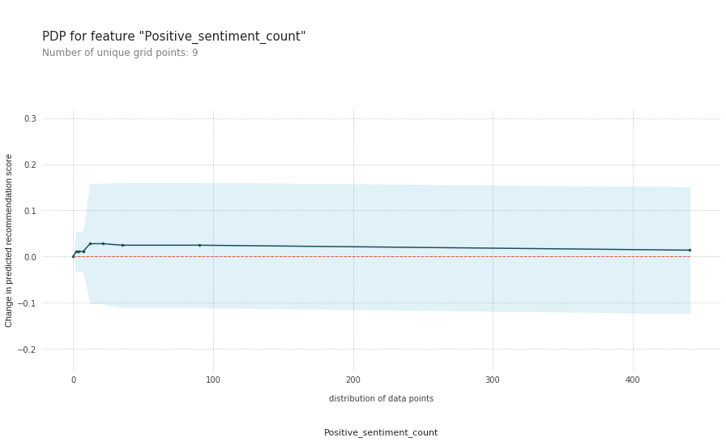
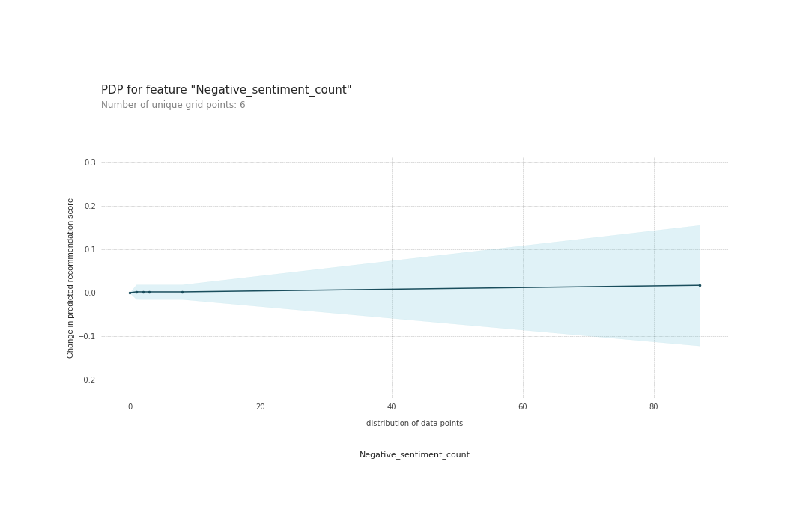
PDP for Positive & Negative sentiment count
Recommendation percent slowly increases till positive count equals 50 and then remains almost constant with increase in count.
Surprisingly in case of negative sentiment, even as negative sentiment count increases the Recommendation percent by the model increases slightly.
But the dependence on sentiment counts is not so significant compared to other important features.
Notes:
X-axis : values of features
Y-axis : change in value of predicted recommendation value w.r.t the feature values
Blue shaded area : level of confidence
Blue line : actual main plot
Red-dotted line : just zero line no significance

